Slide 1

DRW Group 2
PRT565 - Machine Learning, Artificial Intelligence and Algorithms - Assignment 3
Pump Fault Detection
Machine learning and deep learning on industrial sensor data
Van Hoi Dang (Hendrick Dang) – S395598
Le Quynh Nhu Doan (Avery Doan) – S395841
Phuong Tran Tran (Jane Tran) – S395830

Slide 2

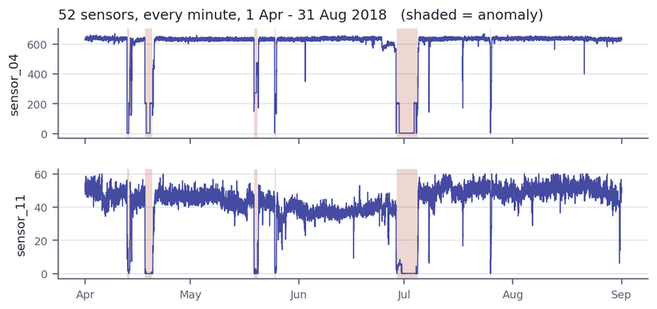
DRW Group 2
Why Pump Failure Matters
The Data
When a pump fails without warning the plant stops and repairs are unplanned. Detecting an abnormal state automatically alerts maintenance immediately.
52 sensors recorded every minute
Supervised classification
220,320 readings, April to August 2018
The Task
Labels: NORMAL, RECOVERING, BROKEN

Slide 3
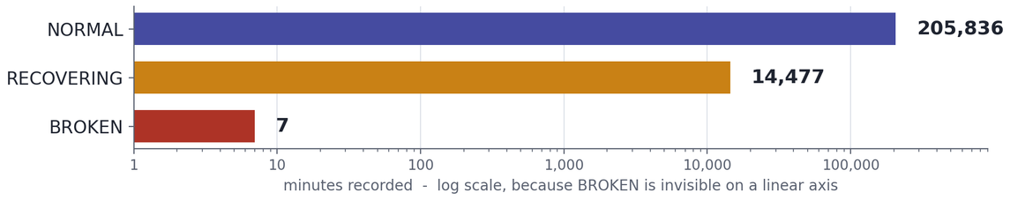
DRW Group 2
Majority class
Imbalanced Target
93.43%
NORMAL: 205,836 rows of healthy operation.
Minority class
6.57%
BROKEN appears only 7 times in 220,320 rows, so RECOVERING and BROKEN were merged into one ANOMALY class.
ANOMALY: 14,484 rows, of which only 7 are BROKEN.
The trap
Our metrics
Accuracy is misleading
What we report instead
Predicting NORMAL for every row scores 93.4% accuracy and catches zero faults.
Precision, Recall, F1-score, ROC-AUC and PR-AUC on the anomaly class.

Slide 4
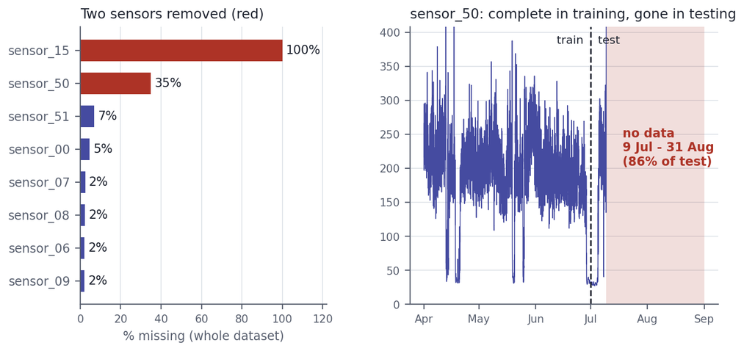
DRW Group 2
01
Drop dead sensors
sensor_15 is 100% missing. sensor_50 is complete in training but 86% missing in testing, 12 SD adrift. Both removed.
Preparing the Data
02
Fill short gaps
Remaining gaps are short sensor dropouts, filled by time-based interpolation rather than a global mean.
Four cleaning decisions, all fitted only on the earlier part of the timeline - the exact split comes next - so nothing from the test period leaks in.
03
Clip outliers
Extreme values clipped to the 0.1 and 99.9 percentile range, with the bounds calculated on training data only.
04
Engineer features
50 raw sensors plus backward-looking 5-minute rolling means and standard deviations, giving 150 features and no leakage.

Slide 5

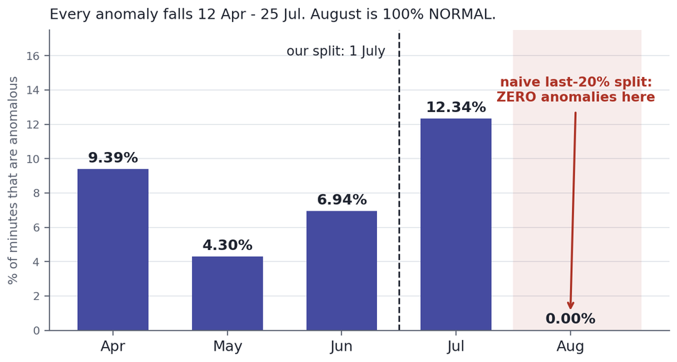
The Split Trap
Time-series data: we train on the past and test on the future. The obvious split destroys the evaluation.
a.
All anomalies fall between 12 April and 25 July. August is 100% NORMAL.
b.
A naive last-20% split lands in August: 44,064 rows, ZERO anomalies.
c.
Splitting on 1 July gives 6.85% train and 6.17% test anomalies.

Slide 6
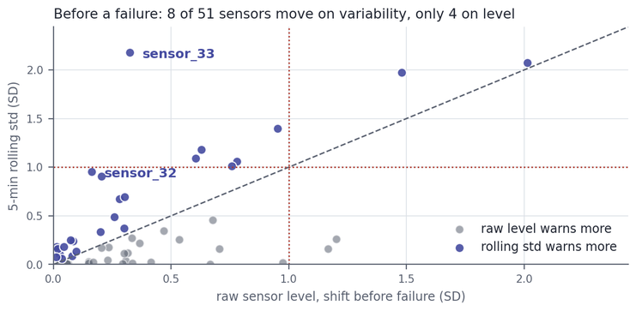
DRW Group 2
Detection, Not Prediction
Sensor | Before failure | During anomaly
sensor_04 | 2.01 SD | 10.48 SD | 5x
sensor_00 | 1.48 SD | 9.75 SD | 7x
sensor_06 | 0.78 SD | 9.34 SD | 12x
sensor_07 | 0.63 SD | 12.77 SD | 20x
RECOVERING always follows the break, so 99.95% of our positive class is a pump that has already failed.
Detection
The sensors that separate a broken pump most clearly are the ones that move least beforehand. These sensors react to failure, they do not anticipate it.
During an anomaly, 20 of 51 sensors move more than one standard deviation.
sensor_07 sits 12.8 SD apart. The classes are almost separable, so expect very high scores.
Prediction
In the hour before a failure, only 4 of 51 sensors shift by more than one SD.
True failure prediction is a much harder problem and the clear direction for future work.

Slide 7
DRW Group 2
Classical ML models Overview
  Four models: Decision Tree, Random Forest, Naive Bayes, ANN (MLP)
  Each row in the dataset is one minute of sensor readings from the pump + rolling 5-min mean/std
  Goal: classify NORMAL vs ANOMALY
Setup recap
  ~93% of data is NORMAL → accuracy is misleading
→ we optimize Precision/Recall/F1/ROC-AUC/PR-AUC instead
  Chronological split: train Apr–Jun, test Jul–Aug (no future leakage)
  Class weighting is used on all 4 models to counter the imbalance

Slide 8
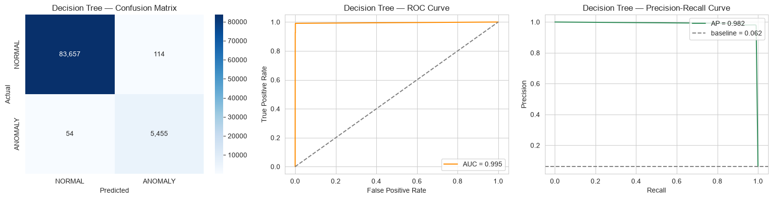
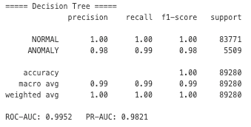
DRW Group 2
Models in detail
Model 1- Decision Tree
  Single tree, max depth 10, class-weighted
  Fast, fully interpretable baseline

Slide 9
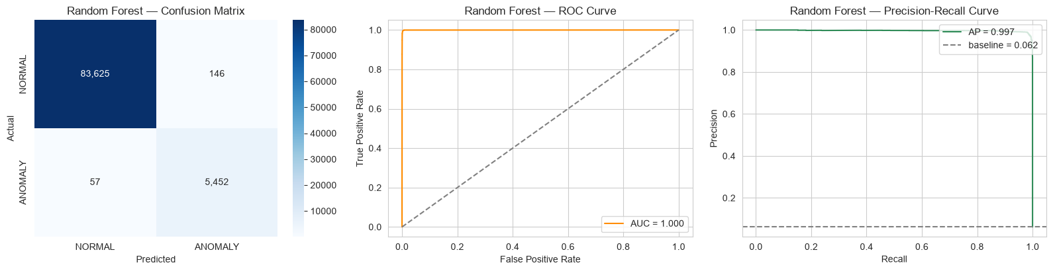
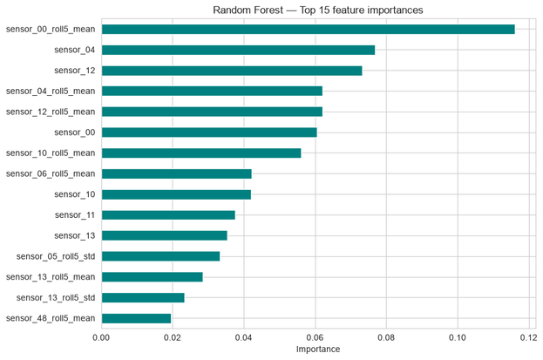
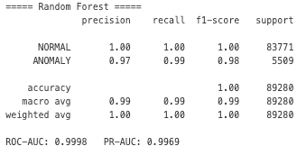
Models in detail
Model 2- Random Forest
  200 trees voting together (ensemble)
  Best-performing model overall
  Top signal: sensor_00 and its rolling stats

Slide 10

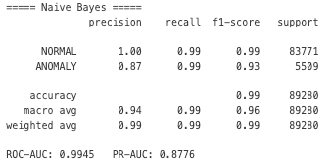
DRW Group 2
Models in detail
Model 3- Naive Bayes
  Assumes all sensors are independent (known to be false- sensors are correlated)
  Included deliberately as a contrast- weakest result confirms sensor correlations matter

Slide 11

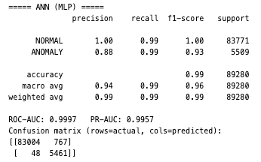
DRW Group 2
Models in detail
Model 4- ANN (MLP)
  Small neural net: 2 hidden layers, dropout, early stopping
  Nearly matches Random Forest without being told sensor relationships explicitly

Slide 12
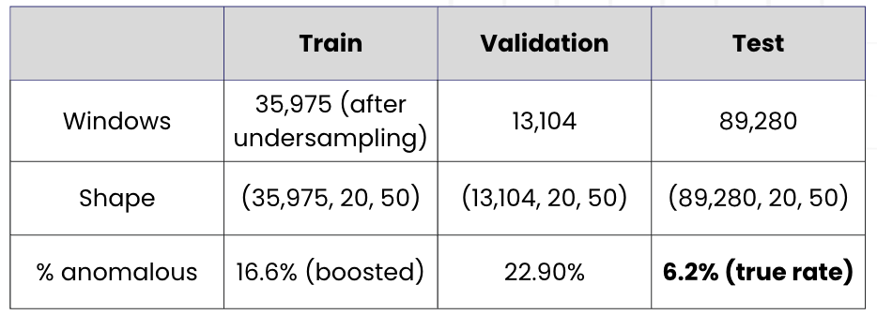
DRW Group 2
Long Short-Term Memory (LSTM)
  Every earlier model (DT/RF/NB/ANN) judges one minute of sensor data at a time
  LSTM instead reads a 20-minute rolling window of all 51 sensors → shape (20, 51)
  Windows only look backward in time — no future leakage
  Same Apr–Jun train / Jul–Aug test split as every other model — directly comparable
  Anomalies are rare → undersample majority NORMAL windows in training only; test set stays real-world imbalanced
⟶ test stays at the real imbalance, only training was rebalanced.

Slide 13
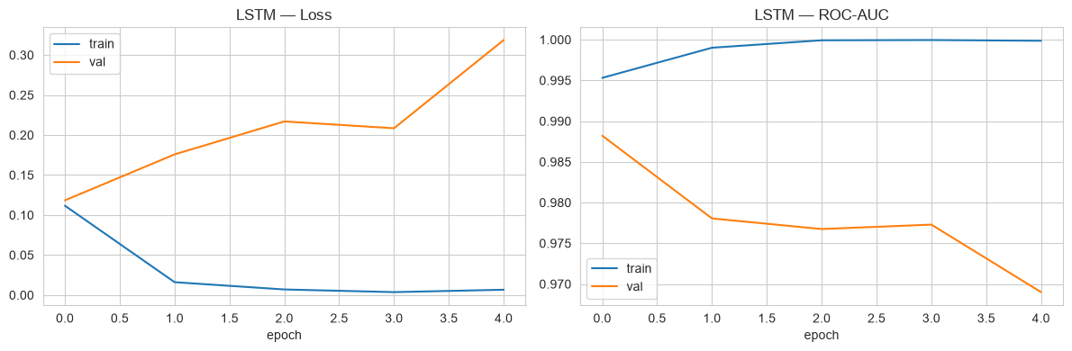
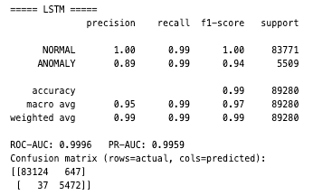
DRW Group 2
The LSTM Model & Headline Results
  2 stacked LSTM layers (64 → 32 units) → dense head → sigmoid output
  Class-weighted training + early stopping on validation ROC-AUC
  Test results:

Slide 14

DRW Group 2
The LSTM Model & Headline Results

Slide 15
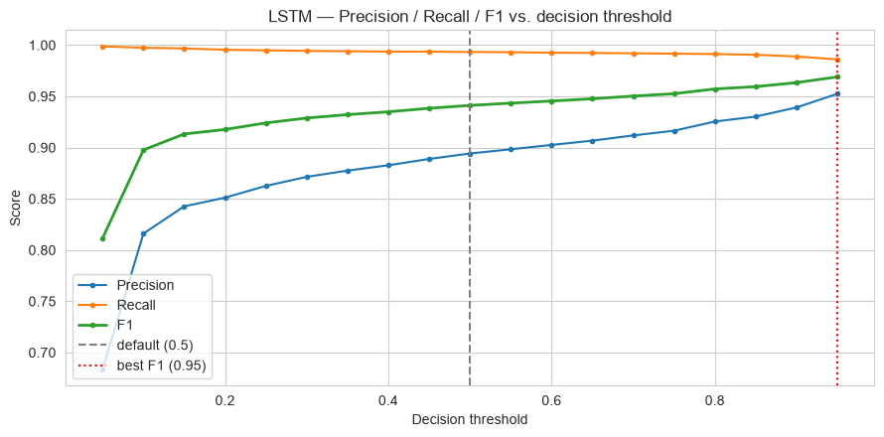
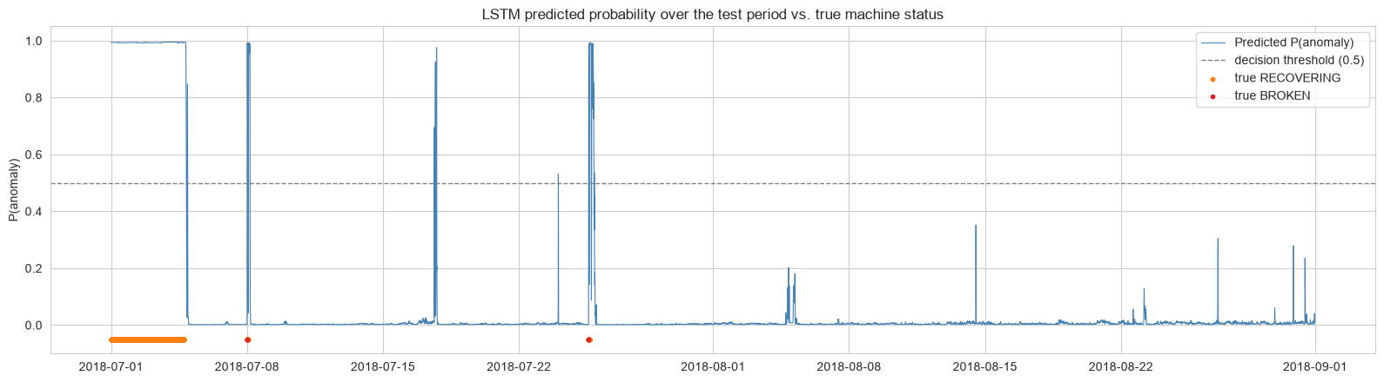
DRW Group 2
Threshold Tuning & Catching Every Failure
  Predicted-probability-over-time plot tracks real anomaly episodes visually
  Default 0.5 threshold → F1 = 0.96; tuned ≈0.95 threshold → F1 = 0.97 (fewer false alarms, same recall)
  Per-episode check: all 3 real anomaly episodes in the test period detected — lag as low as 7 and 11 minutes
  Lesson: never trust the default 0.5 cutoff blindly
Default threshold

Slide 16
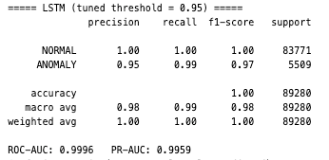
DRW Group 2
Result after tuning

Slide 17
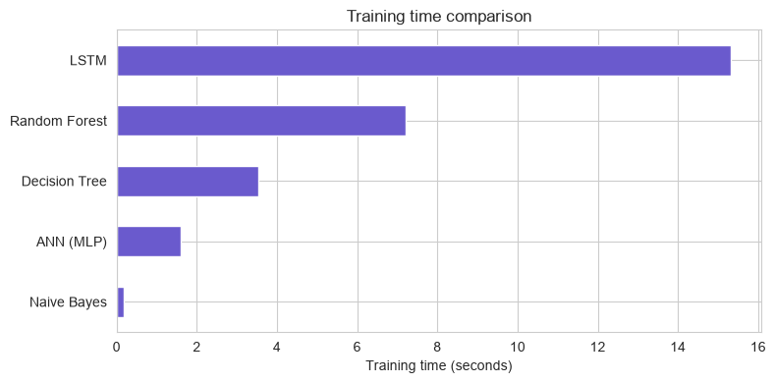
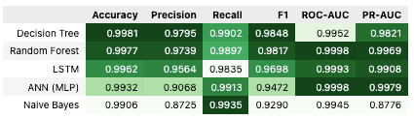
DRW Group 2
Model Comparison: All Five Models
*LSTM precision/recall/F1 shown using the tuned threshold.
  PR-AUC: Random Forest 0.997 (best) · Naive Bayes 0.878 (weakest)
  Every model caught all 3 real anomaly episodes — the one number that never changed
  Training time: Naive Bayes fastest (~0.4s) → LSTM slowest (~16s)

Slide 18
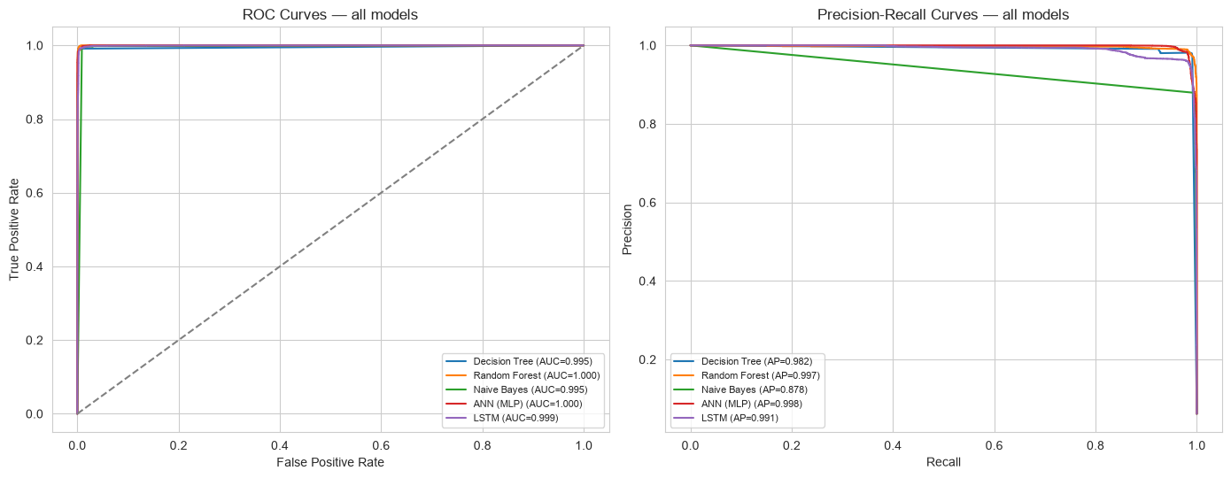
DRW Group 2
Model Comparison: All Five Models

Slide 19
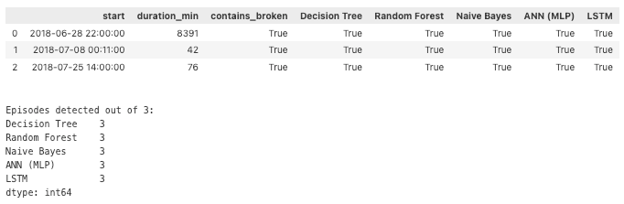
DRW Group 2
Conclusion & Recommendation
  Anomaly rate ~6–7% → a "predict NORMAL always" model looks 93% accurate while catching nothing
  Reproducibility finding: re-ran the whole pipeline 4 times — DT/RF/NB identical every time; LSTM's raw threshold performance swung run-to-run
  What never moved: every real fault, every run, every model — always caught
  Recommendation: Random Forest as primary detector; LSTM as a complementary sequence-aware signal
Which models actually caught each real anomaly episode?

Slide 20
DRW Group 2
Thank You
For Your Attention
Data is not about numbers, it's about understanding

